Slide 1
Embedded Systems Design
Hassan Saeed M. Ibrahim Zafar
Abbas Ahmad Momin Munir
Saqib Javed Saad Abdul Majid

Slide 2
Smart Parking Lot using 8051 Microcontroller.

Slide 3
Basic Explanation
Entrance and Exit barriers Control motor.
Count and display the number of cars in the Lot.
LDR monitors whether it’s Day/Night to switch the lights in the Lot On/Off.

Slide 4
Empty lot, irrespective of Day/Night condition, Lights are switched off.
Full lot, Entrance Barrier doesn’t operate to accommodate incoming vehicle.
Stepper Motor Speed &Angle Control to induce flexibility in design.

Slide 5
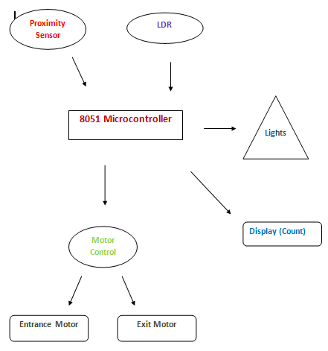
Block Diagram

Slide 6
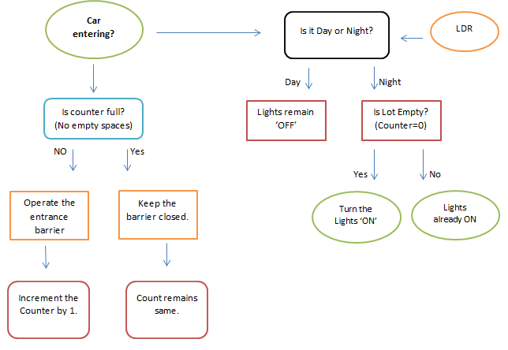
Flow Chart

Slide 7
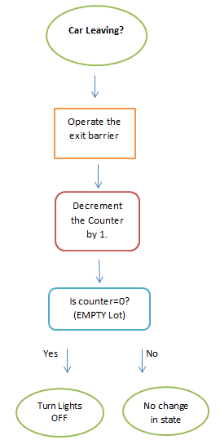

Slide 8
Usability
Managing parking lots in today’s busy traffic is a growing problem.
Cost effective Proposal (low unit cost).
Equipment's used will be easily available.
Reduces Human effort to a large extent.

Slide 9
Power efficient- Caters the power crisis issue.
Compact design-easy to install.
Good performance-real time.
Easy to use hardware.

Slide 10
Additional Information
8051 Micro Controller.
LCD Display to display the Count of Vehicles.
Stepper motor for Barrier movement.
LDR for Day/Night Monitoring.
Sensors for Vehicle detection (Most probably IR)
LEDs
We will also be controlling the stepper motor Speed and Angle.

Slide 11
Correction
As directed by instructor following additions were done
Addition of LED’s panel to display free space/used space and their location. Each parking space has a sensor to transmit the availability.Allows user to get directions at the entrance.

Slide 12
Correction
Multiplexing greater number of parking spaces to adjust on a single microcontroller.
Distinguish between heavy and light vehicles by adding secondary IR sensor at a certain height. The gate angle changes accordingly.

